Slide 1

Slide 1
U.S. Military
Casualty Analysis
1980 - 2010
Presented By: Ashton Wolf
Notes:
Good afternoon, everyone. My name is Ashton, representing the newly created I Corps Data Warfare Team. Thank you for being here today. I am excited to present a very interesting and educational historical dataset of U.S. military fatalities from 1980 to 2010. This dataset interested me due to my career, particularly my early career in the 2000s, and my repeated exposure to military fatalities. Additionally, I was interested on the how the military has changed over the 40-year period and how its culture, missions, economic and environmental factors have impacted the force and the data.

Slide 2
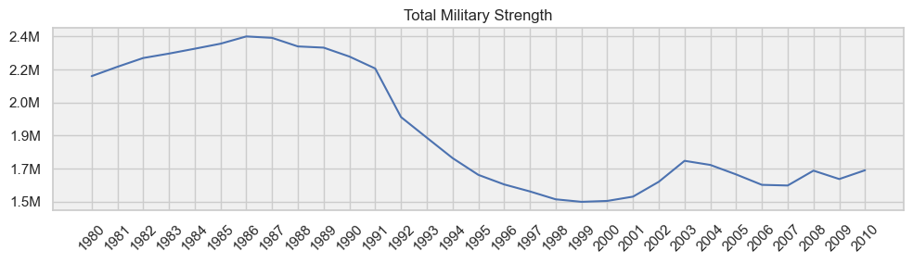
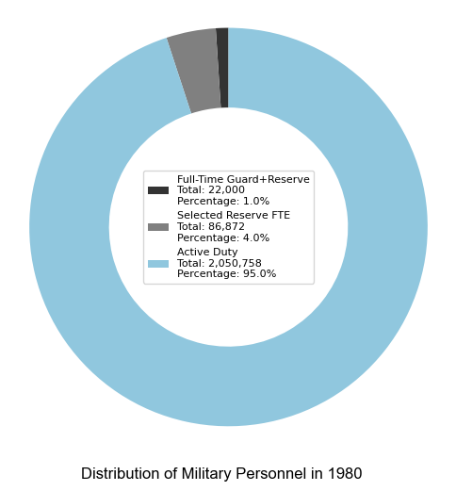
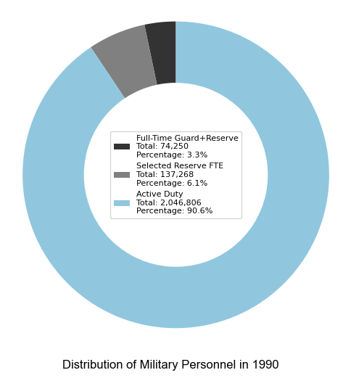
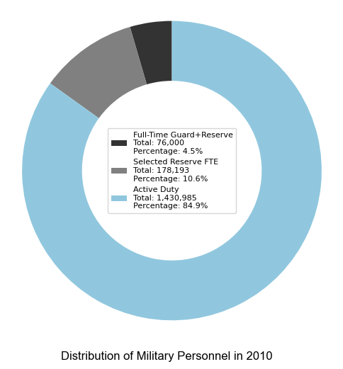
Slide 2
HISTORICAL MILITARY STRENGH
2
Notes:
[Objective] The main objective of this analysis was to develop visual charts based on the dataset and provide valuable insights into the trends and patterns observed in U.S. military fatalities during that time period. The baseline used was the current calendar year military strength and compare it against the different fatality categories.
[Visualizations] In order to better understand the data, I created a range of compelling visualizations. I utilized several line plots, two variations of doughnut charts, and bar charts to effectively represent the information and uncover significant findings.
The line plots allowed me to present the year-by-year changes in total military strength. I formatted the graphs in a way where the data and trends of that data can be quickly gathered. By observing these charts, we can gain insights into the evolution of the U.S. military over the course of 40 years to include the Cold War, Desert Storm and the subsequent drawdown, and the gradual buildup in the 2000s as the War on Terror started. Additionally, the doughnut charts helped illustrate the distribution of forces across different years, providing a comprehensive snapshot of the military landscape and illustrating the categories by weight.

Slide 3




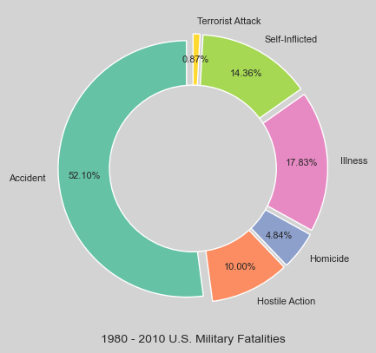



Slide 3
Fatality Breakdown By Category
52%
14%
14%
ACCIDENTS
SELF-INFLICTED
SELF-INFLICTED
Vehicle collisions
Drownings
Substance Abuse
Equipment Malfunction
Deployment Stress
Substance Abuse
Relationship Challenges
Financial Struggles
Military to Civilian Transition
17%
10%
10%
ILLNESS
HOSTILE ACTION
HOSTILE ACTION
Cancer
Heart Disease
Diabetes
Infection
Combat Environment
Improvised Explosives
Environmental Factors
3
Notes:
To explore the categorical breakdown of U.S. military fatalities, I employed doughnut charts, which visually depicted the proportions of different causes such as accidents, illnesses, self-inflicted incidents, hostile actions, homicides, and terrorist attacks. These charts provided valuable insights into the relative significance of each category. The charts also illustrate the percent of the total recorded fatalities for that time period.

Slide 4


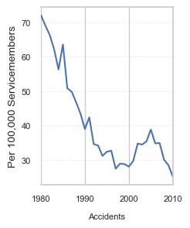
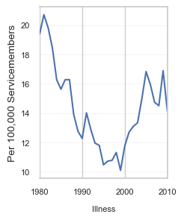
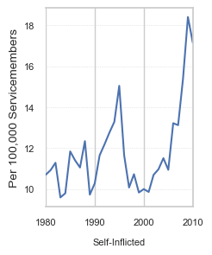
Slide 4
DATA TRENDS OVER TIME
52%
17%
14%
Accidents
Illness
Self-Inflicted
Key Contributors
Accident Prevention Plans
Increased Training
Motorcycle Safety Courses
Command Safety Programs
Key Contributors
Advances in medical care
Smoking Cessation Program
Improved medical screening
Increased Immunizations
Key Contributors
Increasing Military Operations
Mental Heath Awareness Programs
Toxic workplace environments
Sexual Harassment/Assault
4
Notes:
Furthermore, I used line charts to analyze the trends in different categories of fatalities per 100,000 soldiers. By focusing on accidents, illnesses, self-inflicted incidents, hostile actions, homicides, and terrorist attacks individually, we were able to observe the changes and identify any notable patterns.

Slide 5



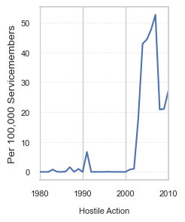
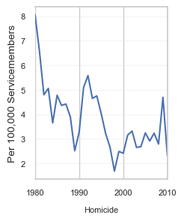
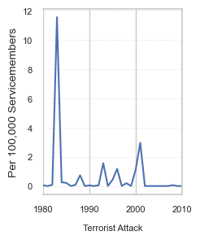
Slide 4
DATA TRENDS OVER TIME
10%
4.8%
0.87%
Hostile Action
Homicide
Terrorist Action
0.87%
Terrorist Attack
Key Contributors
Operation Desert Storm (1991)
Operation Restore Home (1992-1993)
Operation Enduring Freedom (2001-2014)
Operation Iraqi Freedom (2003-2011)
Key Contributors
Military Safety Programs
Increased Base Security Measures
Command Policy Initiatives
Mental Health Treatment
Key Contributors
Beirut U.S. Embassy Bombing (1983)
Oklahoma City Bombing (1995)
USS Cole Bombing (2000)
September 11th Attacks (2001)
4

Slide 6
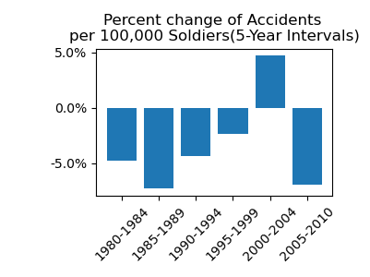
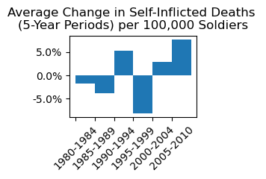
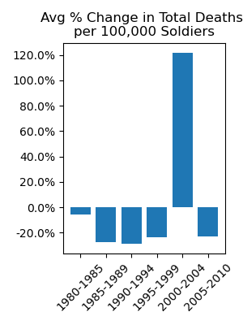
Slide 5
DATA TRENDS PERCENTAGES
ACCIDENTS
SELF-INFLICTED
TOTAL DEATHS
Significant decrease in the 1980s 1990s
Diminishing decrease of accidents over time
Overall percentage drop is approx. 73%
Minor decreases in the 1980s
5% increase in early 1990s
Moderate increases in 2000s
War on Terror spike from 98-2004 of 120%
73%
80%
120%
5
Notes:
Lastly, I employed bar charts to demonstrate the percentage changes in fatalities per 100,000 soldiers over 5-year periods against accidents, self-inflicted and total deaths. These charts allowed us to assess the effectiveness of safety programs, mental health awareness and treatment strategies, and identify any shifts in trends over time. The total deaths chart explicitly shows the dramatic rise due to the combat operations in Afghanistan and Iraq.
[Key Findings] Among the numerous insights derived from this analysis, one finding stands out as particularly significant. The rate of fatal accidents exhibited a substantial decline from 1980 to 2010. This decline can be attributed to the implementation of safety programs, enhanced military training, the introduction of protective equipment, and cultural shifts within the military. I was able to calculate that between 1980 and 1995, there was a drop of approximately 73%.

Slide 7
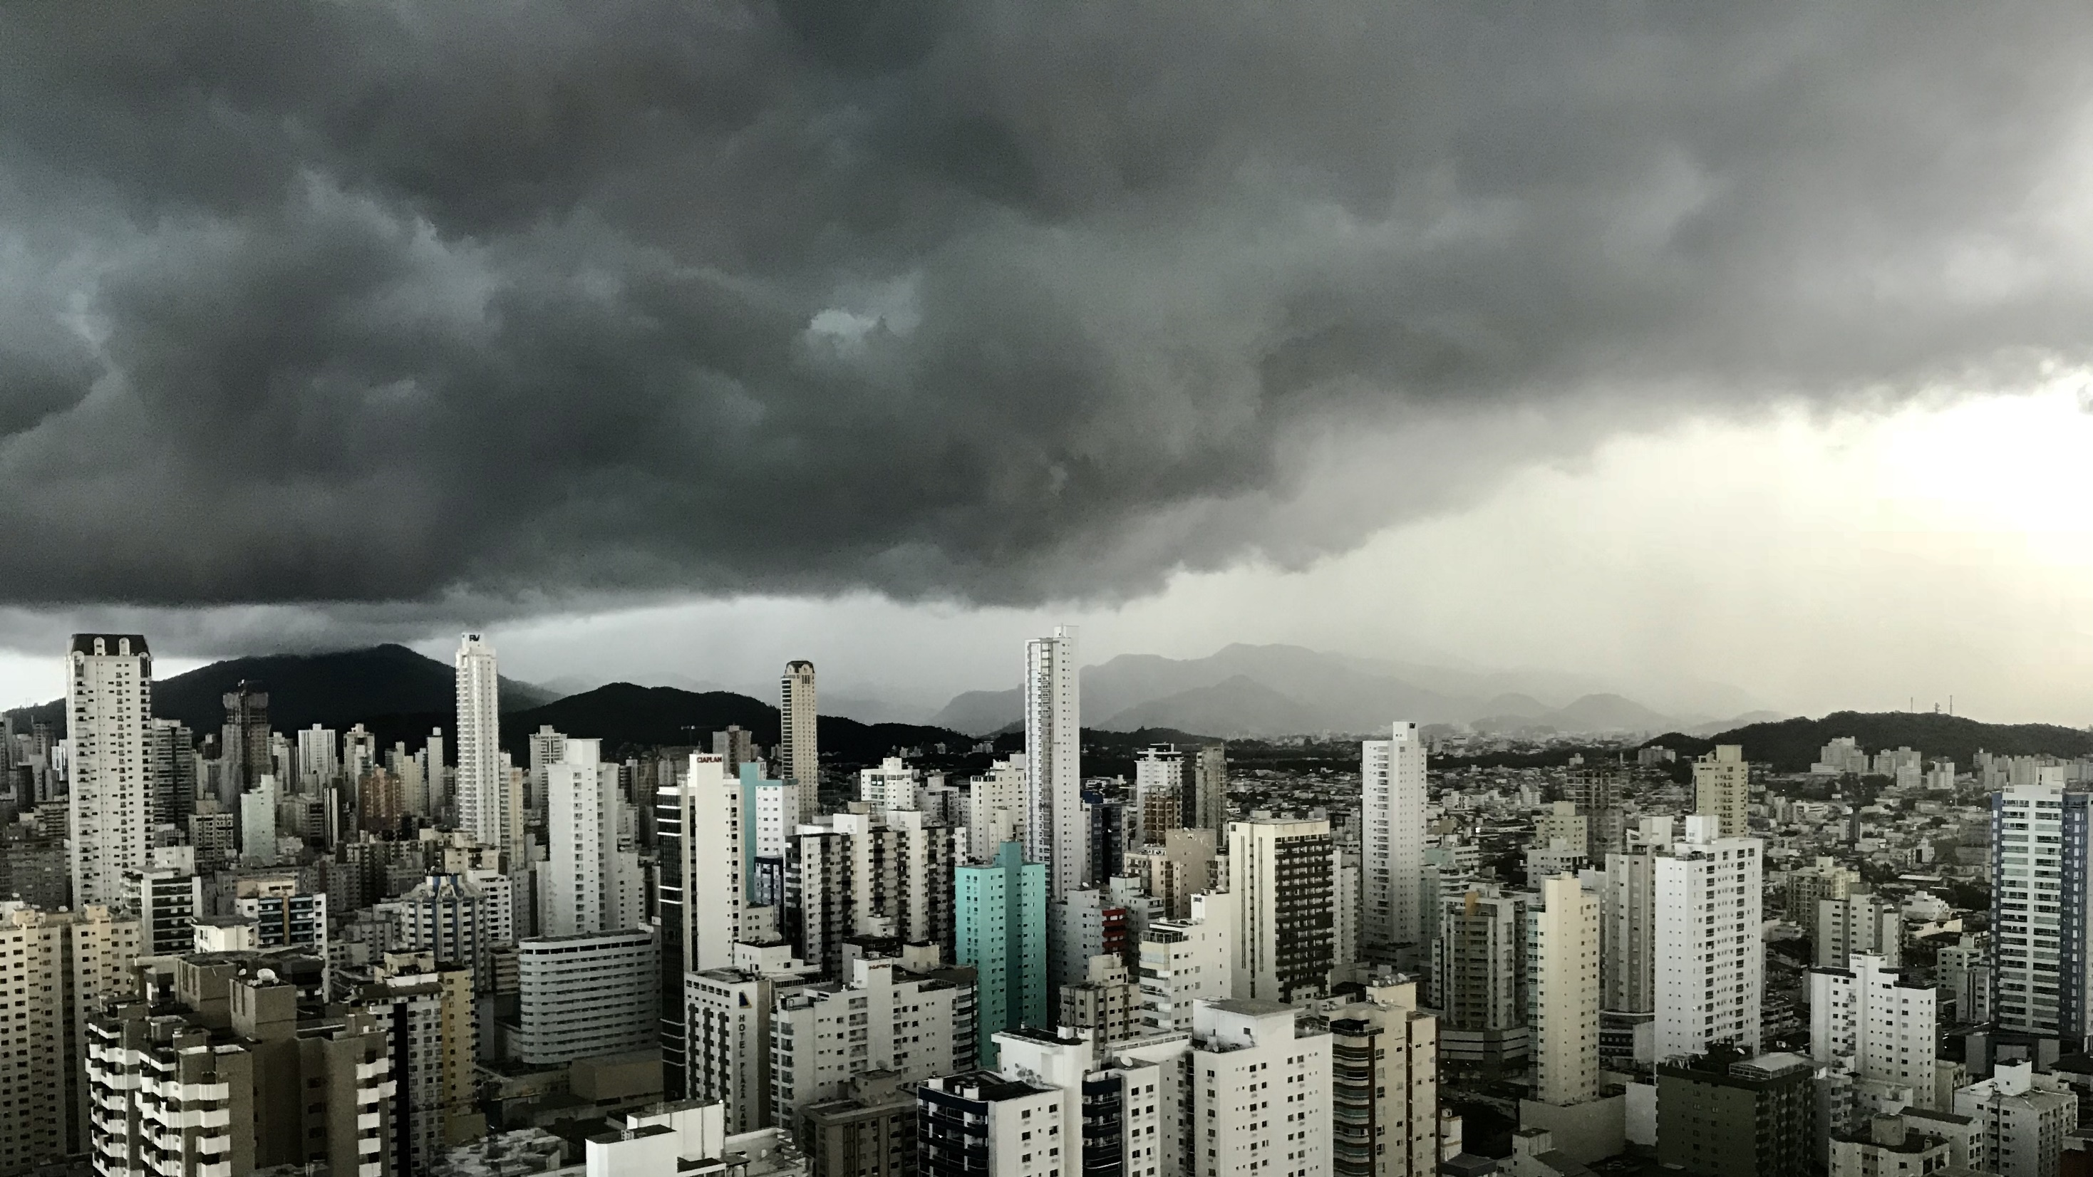
Slide 11
THANK YOU
Contact Information
Email: ashton.wolf@yahoo.com
GitHub: wolfman1986 (ashtonW) (github.com)
LinkedIn: www.linkedin.com/in/ashton-wolf
Notes:
[Interpretation and Utilization] The results of this analysis provide historical insights into the U.S. military population, culture, and the impact of various factors on the statistical data. They offer an understanding of how changes in military operations, policy initiatives, training practices, technology adoption, and demographic shifts have influenced the trends in military fatalities over time.
The findings can be utilized to inform decision-making processes within the military, aid in the development of effective safety programs, and contribute to the ongoing efforts to protect and safeguard the lives of our servicemen and women.

